Slide 1
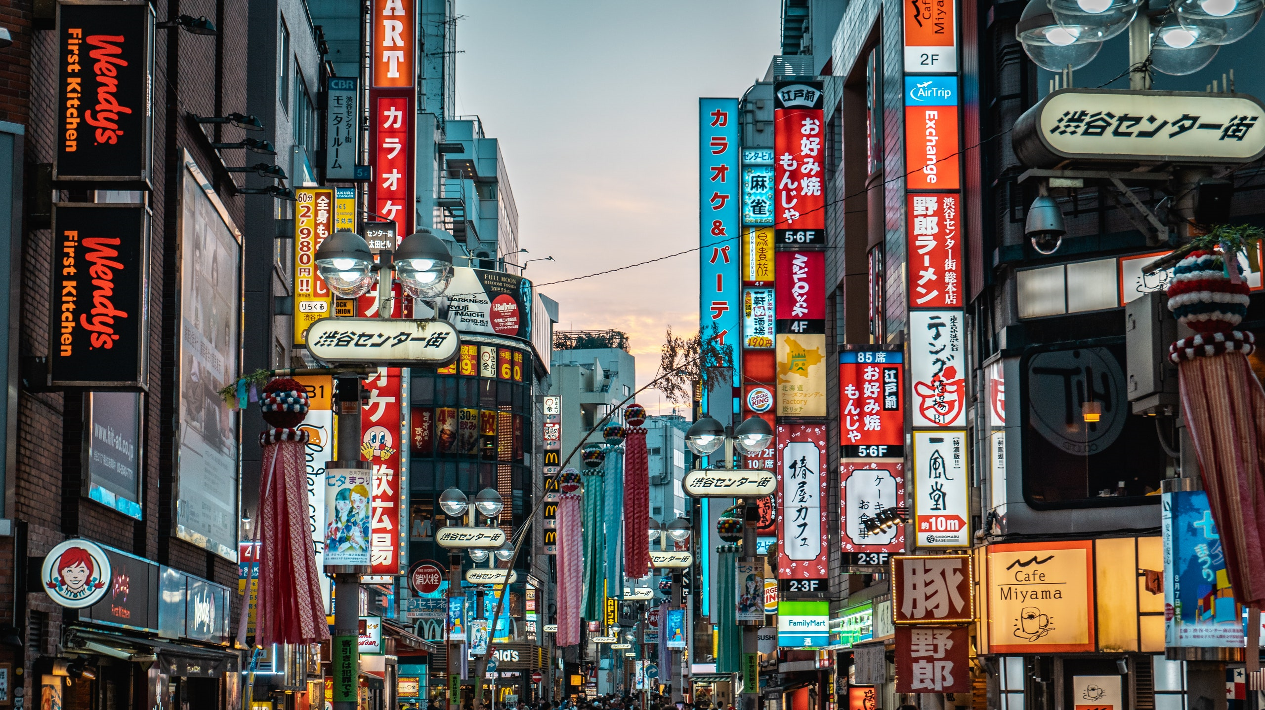

Otaku Haven
Gavin Binder Raul Lopez Renato Silva e Silva

Slide 2

About whom we are:
We first started our business shortly after the pandemic, to bring joy back to many people across the globe in an affordable and fast way.
Our main goal is to provide to lovers of Asian cultures the best of the best, no matter in the world they may be, no matter if its anime, K-pop, J-pop, manga, figurines, idol merch, we got you.
RD

Slide 3
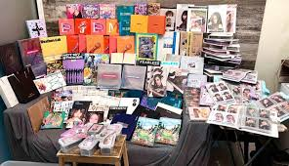
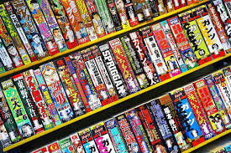
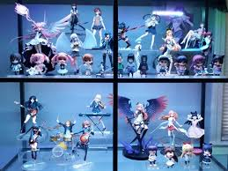
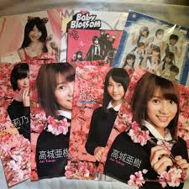
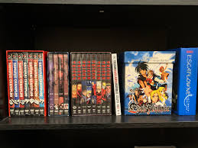
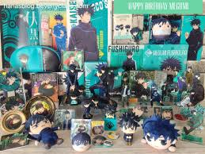
SOME of Our products
K-pop and J-pop
Manga/Anime
Anime Merchandise
RD

Slide 4
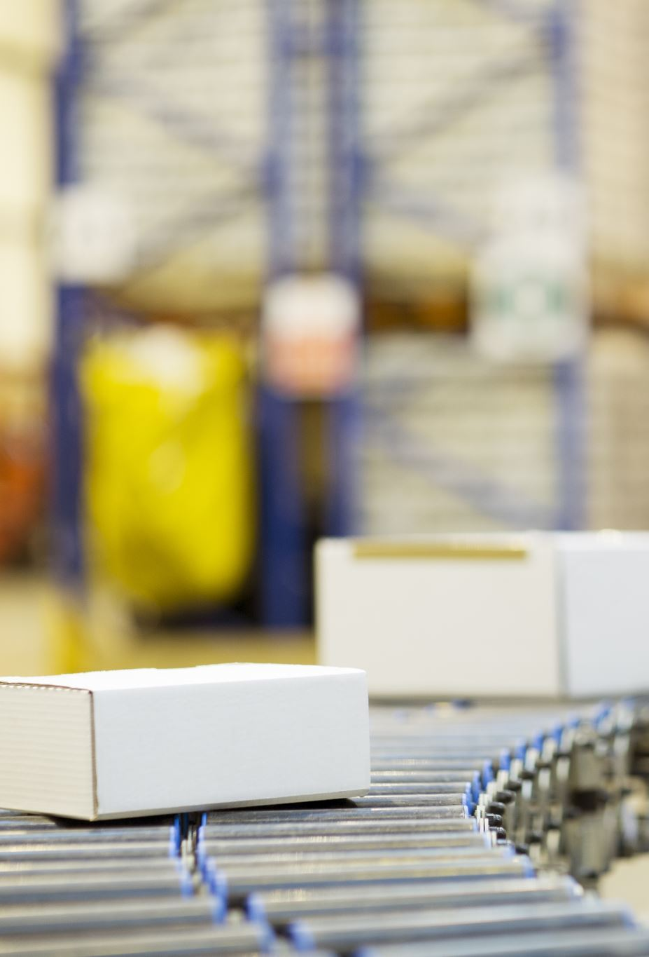
Problem and solution
Some problems we have had include:
Keeping track of employee and customer information.
Keeping track of sales.
Tracking and updating stock.
Managing supplier relationships.
We plan to use our database to store customer, employee, invoice, product sales, inventory, and supplier information to help fix these issues.
RD

Slide 5
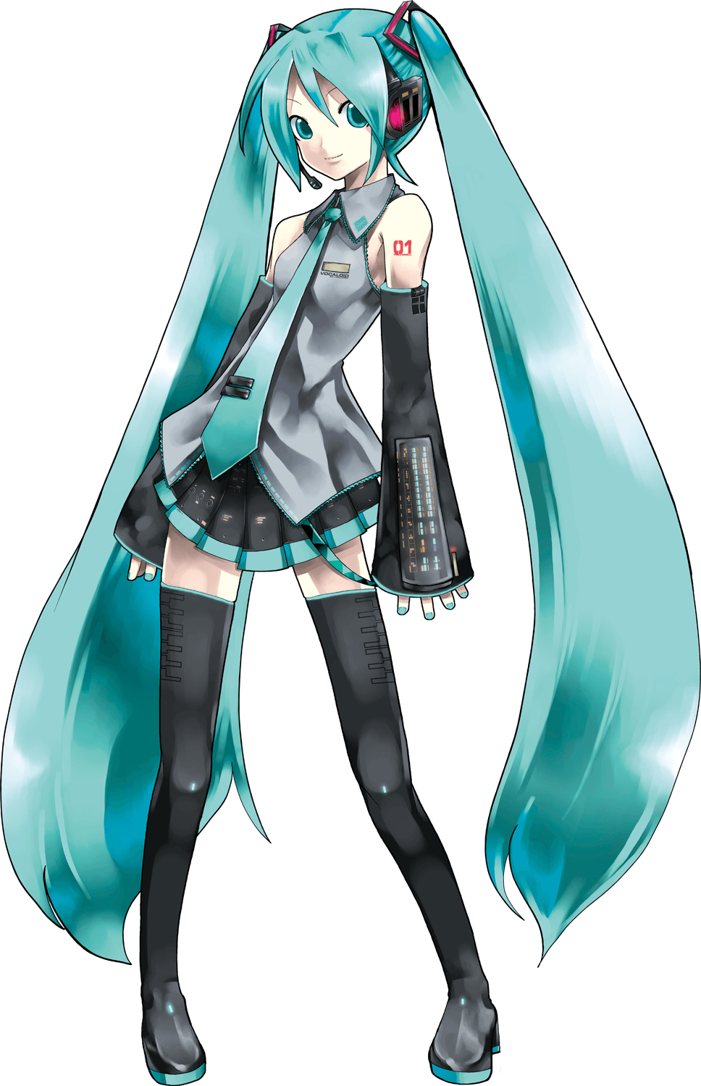

Constraints and objectives
Some constraints for this database include:
Each table (customer, employee, invoice, line, inventory, and supplier) must have a unique identifier (primary key)
Related tables must be connected through foreign keys (Eg. Inventory to supplier)
Database must be free of data redundancy and any inconsistency (3NF).
Some objectives for this database include:
Ability to manage customer, employee, and supplier information.
Capability to track sales for inventory management.
Tracking company profits/losses and monitoring sales
The database must have functionality, permitting administrators to manipulate it and extract
RL

Slide 6

KeY Business Rules
Should be able to track which items are sold, that way the inventory can be updated appropriately.
Inventory should track the supplier of an item, that way when inventory is low we can notify the supplier.
Invoices are created by employees, and received by customers. They should include the total amount purchased.
Line includes every item on an invoice.
RL

Slide 7
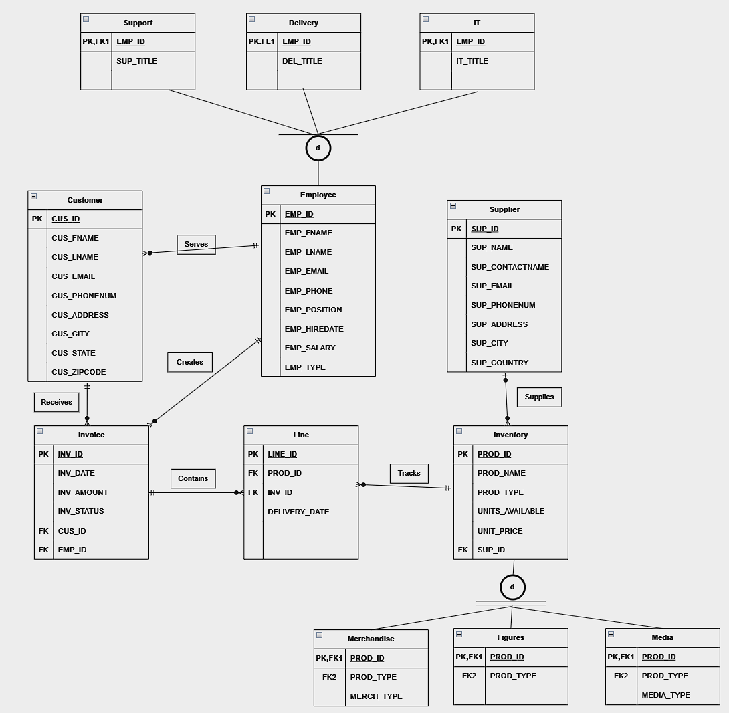
ERD
RL

Slide 8
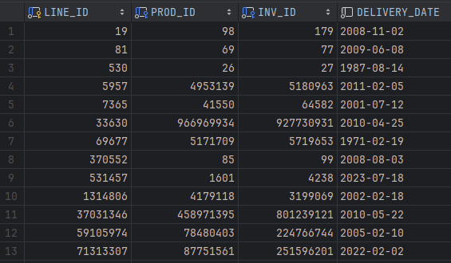
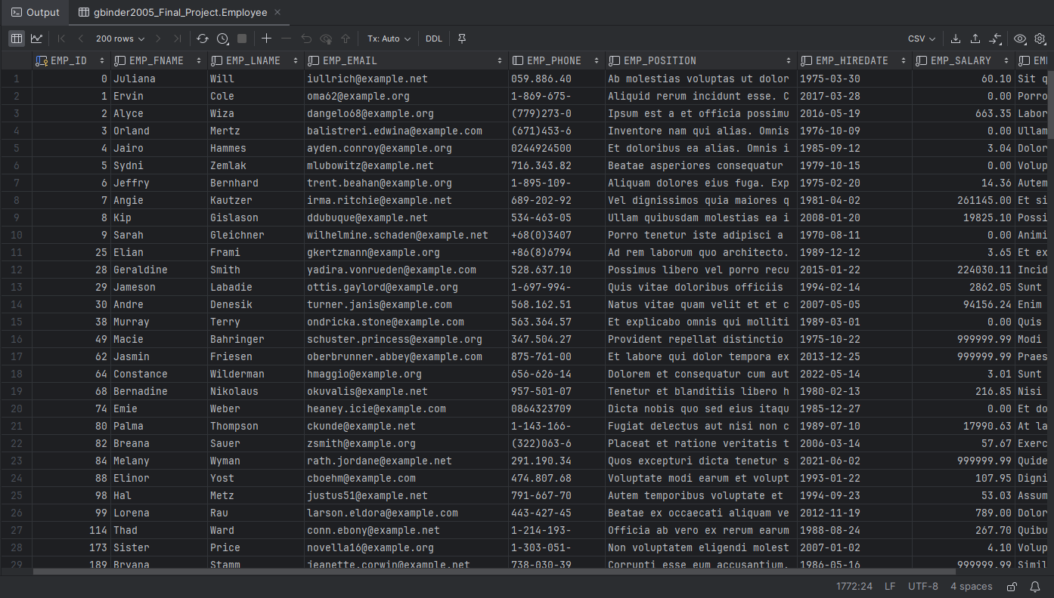
Database EXAMPLE
GB

Slide 9

Biggest Challenge
Our greatest challenge was organizing our schedules to be able to meet up and work together on the project. Once we all had the time, things went smoothly.
GB

Slide 10
What we Learned
Renato: I was able to learn in depth the complexity of an actual database when it is used to solved a company's issue, and how well we worked as a team tackling each of us a specific task we excel at.
Raul: The biggest takeaway I had was being able to apply a business lens to my CS mind. It was interesting to consider real-world limitations and tie profits to code.
Gavin: I really enjoyed learning how our theoretical knowledge could be applied to a real-world scenario. I think it was fun to visualize a database on our own, rather than something created for us.
ALL

